Slide 1
Data Abstraction and Encapsulation
Jino Joseph
10th June 2020

Slide 2
Data Abstraction
A process of exposing all the necessary details and hiding the rest .
The process of reducing the object to its essence so that only the necessary characteristics are exposed to the users.

Slide 3
Data Abstraction
Abstraction defines an object in terms of its properties (attributes), behavior (methods), and interfaces (means of communicating with other objects).
An abstraction is any named entity that contains a selection of data and behaviors specific to a particular usage of the originating entity.

Slide 4
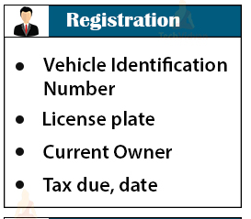
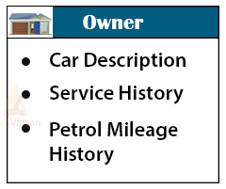

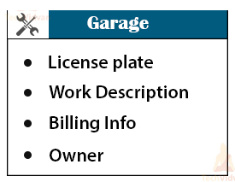
Data Abstraction

Slide 5
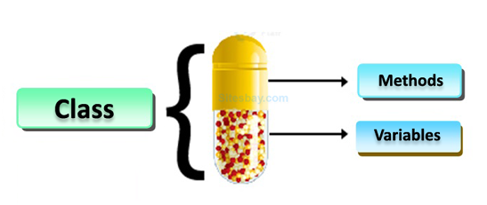
Data Encapsulation
Encapsulation, in general, is the action of enclosing or binding something.
It is a way of combining both data and functions that operate on that data, into a single unit.

Slide 6
Data Encapsulation
Encapsulation may also refer to a mechanism of restricting the direct access to some components of an object, such that users cannot access state values for all of the variables of a particular object.
The advantage of using data encapsulation comes when the implementation of the class changes but the interface remains the same.

Slide 7
Data Encapsulation
Suppose an employee of the Production department wants to know the quantity of raw material that has been purchased for the next month. The employee would not be allowed to go through the data files of the Purchase dept.
Rather he will have to issue a memo to the ‘Purchase’ department requesting for the required information. Then some employees of the Purchase dept will go through the data files of Purchase and send the reply with the asked information.

Slide 8
Let’s Explore…

Slide 9
Abstraction and encapsulation are complementary concepts: abstraction focuses on the observable behavior of an object...encapsulation focuses on the implementation that gives rise to this behaviour
Or
An abstraction relates to how an object and its behaviors are presented to the user and encapsulation is a methodology that helps create that experience.

Slide 10
One family wants to get through a tunnel. Dad can make it in 1 minute, mama in 2 minutes, son in 4 and daughter in 5 minutes. Unfortunately, not more than two persons can go through the narrow tunnel at one time, moving at the speed of the slower one.
Can they all make it to the other side if they have a torch that lasts only 12 minutes and they are afraid of the dark?
Help the family!!!

Slide 11
Thank You

